Slide 1
1. Covert the following numbers to the indicated radix numbers.
(1111011.01)₂= (173.2)₈= ( 123.25 )₁₀ = ( 1111011.00100101)_{BCD}
(10010100.0101 0010 0100)_{BCD}= (94.524)₁₀= (1011110.10000110001001001101110100101111000110101001111111)₂= (5E.8624DD2F1A9FC)₁₆
2. The Boolean expression A +0 is equal to (a)
(a) A (b) A’ (c) 0 (d) 1
3. The output of an OR gate with inputs A, B, and C is a 1 (HIGH) when ( d )
(a) A = 1, B = 1, C = 1 (b) A = 0, B = 0, C = 1
(c) A = 0, B = 0, C = 0 (d) only answers (a) and (b)
4. Calculate the following
(1) (00111000) _{BCD} + (10000011) _{BCD}= 121
(2) (00111000) ₂ + (10000011) ₂= 187

Slide 2
5. Complete the following table of equivalent values. Use binary numbers with a sign bit and 7 bits for the value
Decimal | Sign-magnitude | 1’s complement code | 2’s complement code
102 | 0110 0110 | 0110 0110 | 0110 0110
-68 | 1100 0100 | 1011 1011 | 1011 1100

Slide 3
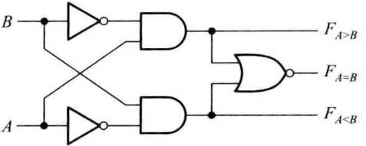
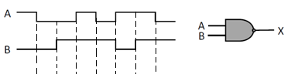
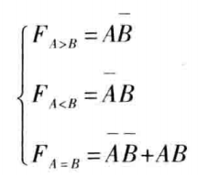
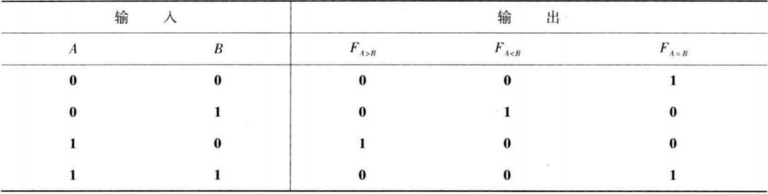
6. Write the logic expression of a 1-bit comparator, draw the circuit, and complete the time diagram.
Logic expression:

Slide 4
1.(10p) Write the logic expression of a 1-bit comparator, draw the circuit, and complete the time diagram.
L_{A>B}
L_{A<B}
L_{A=B}

Slide 5
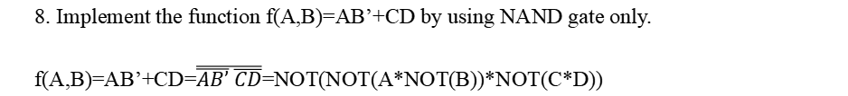
7. Using Boolean algebra, simplify the following expression:$\overline{A}B+\overline{A}B\overline{C}+\overline{A}BCD+\overline{A}B\overline{C}\overline{D}E$
$\overline{A}B+\overline{A}B\overline{C}+\overline{A}BCD+\overline{A}B\overline{C}\overline{D}E$= $\overline{A}B(1+\overline{C}+CD+\overline{C}\overline{D}E)$= $\overline{A}B$
8. Implement the function f(A,B)=AB’+CD by using NAND gate only.
f(A,B)=AB’+CD=$\overline{\overline{AB’} \overline{CD}}$=NOT(NOT(A*NOT(B))*NOT(C*D))
A
B’
C
D
Y

Slide 6
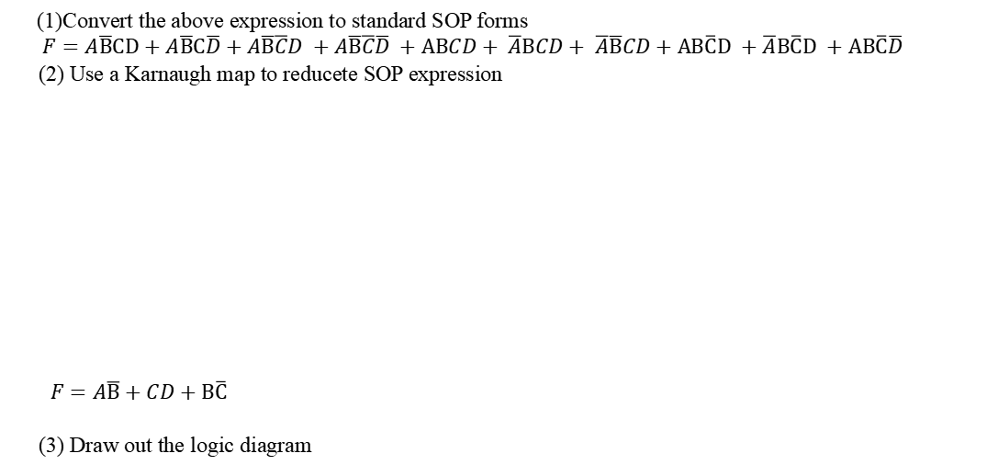
9. Simplify the following boolean functions
(1)Convert the above expression to standard SOP forms
$$F=A\overline{B}CD+A\overline{B}C\overline{D}+A\overline{B}\overline{C}D +A\overline{B}\overline{C}\overline{D} +ABCD+ \overline{A}BCD+ \overline{A}\overline{B}CD+AB\overline{C}D +\overline{A}B\overline{C}D +AB\overline{C}\overline{D}$$
(2) Use a Karnaugh map to reducete SOP expression
$F=A\overline{B}+CD+B\overline{C}$
(3) Draw out the logic diagram
AB
CD
00
01
11
10
00
0 | 1 | 1 | 1
0 | 1 | 1 | 1
1 | 1 | 1 | 1
0 | 0 | 0 | 1
01
11
10

Slide 7
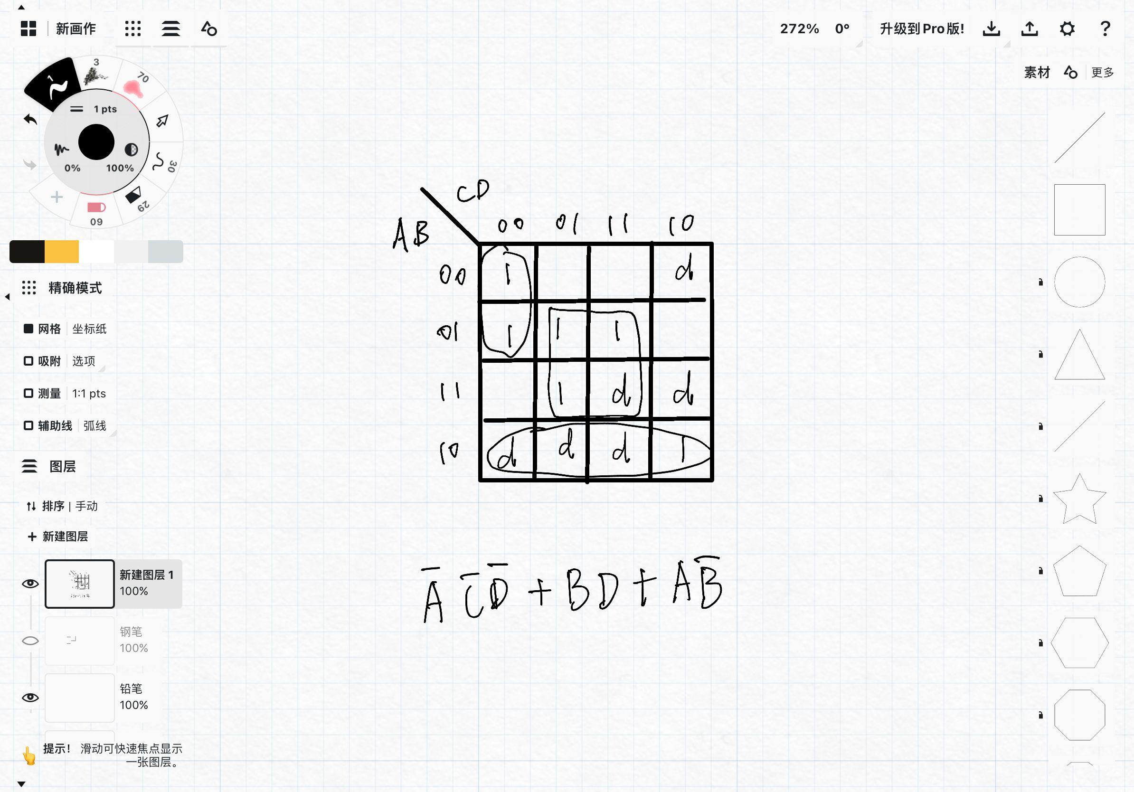
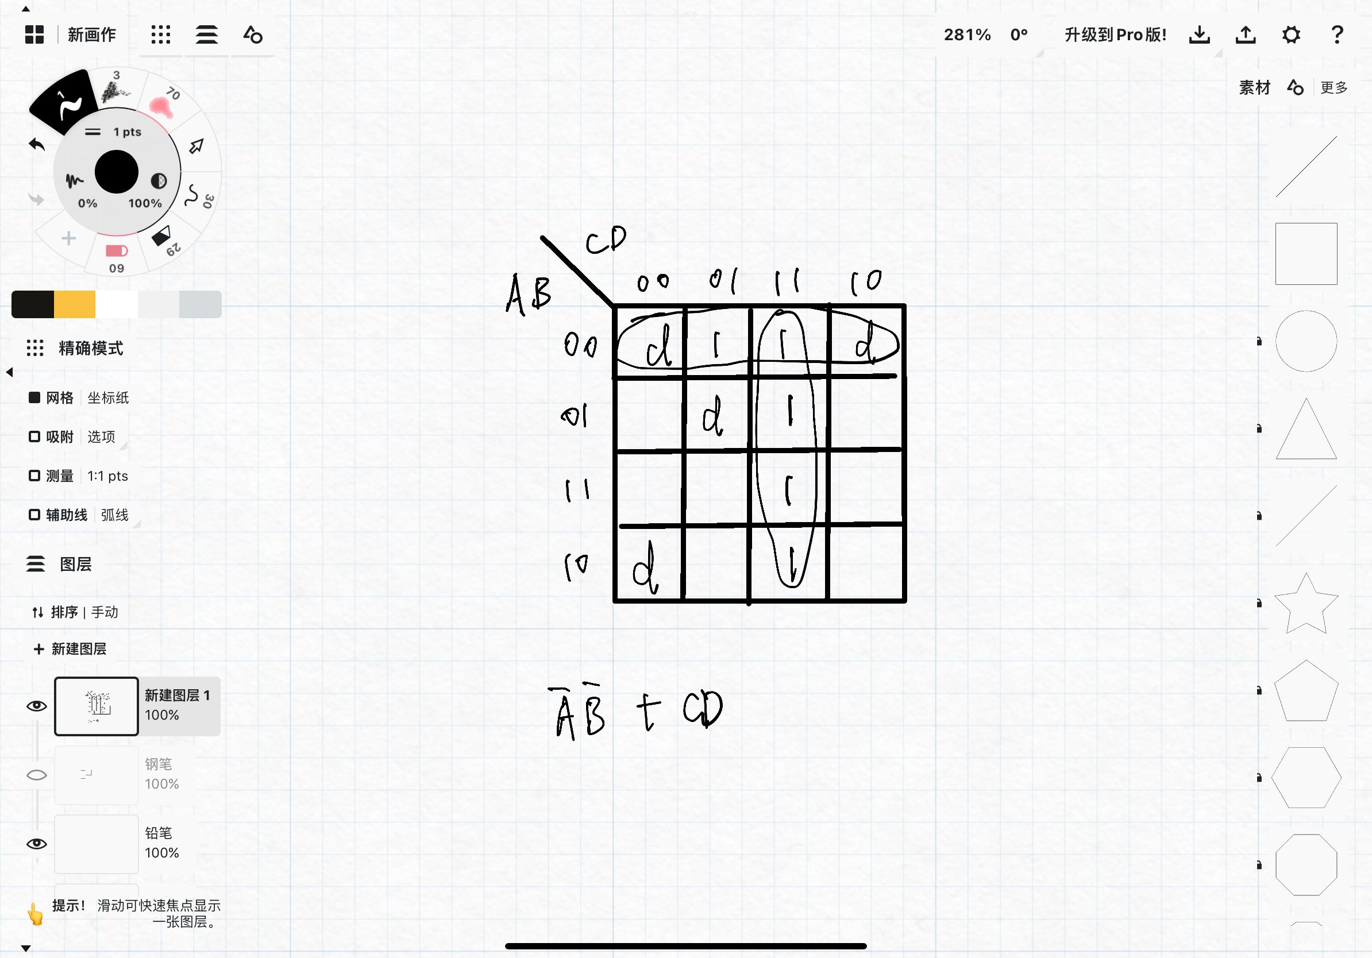
10. Use a Karnaugh map to reduce the expression:
F(A,B,C,D) = ∑m(0,4,5,7,10,13) + ∑d(2,8,9,11,14,15)
11. Optimize the functions ƒ(a,b,c,d ) = Σm(1,3,7,11,15) + Σd(0,2,5,8) in a minimum sum-of-products expression using a Karnaugh map.

Slide 8
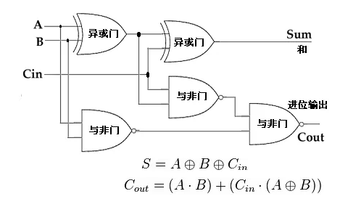
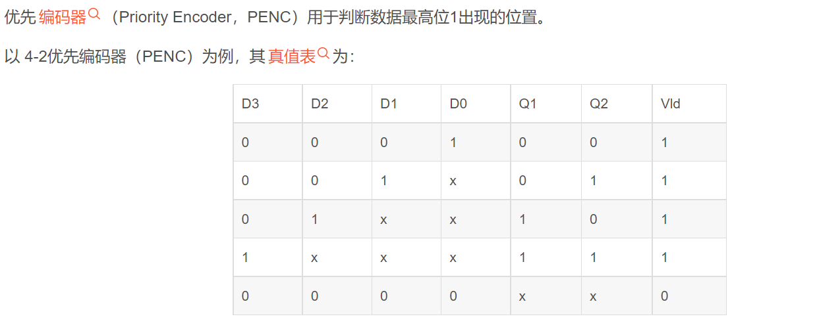
The inputs to a full adder are A=1, B=0, Cin=1, The outputs are Σ=_____, Cout=________
0
1
2. if a octal-to-binary priority encoder has its 0,2,5,and 6 inputs at the active level, the active-HIGH binary output is ()
(a) 110 (b) 010 (c) 101 (d) 000
A

Slide 9
4. Give the truth table of a 1-bit full adder, and implement it using 1-of-8 multiplexer.
a | b | c_{i-1} | s | c_{i}
0 | 0 | 0 | 0 | 0
0 | 0 | 1 | 1 | 0
0 | 1 | 0 | 1 | 0
0 | 1 | 1 | 0 | 1
1 | 0 | 0 | 1 | 0
1 | 0 | 1 | 0 | 1
1 | 1 | 0 | 0 | 1
1 | 1 | 1 | 1 | 1
74LS151
74LS151
D₀
D₁
D₂
D₃
D₄
D₅
D₆
D₇
D₀
D₁
D₂
D₃
D₄
D₅
D₆
D₇
D₀
D₁
D₂
D₃
D₄
D₅
D₆
D₇
0
0
0
1
0
1
1
1
D₀
D₁
D₂
D₃
D₄
D₅
D₆
D₇
0
1
1
0
1
0
0
1
s
c_{i}
Y
Y
G A₂ A₁ A₀
G A₂ A₁ A₀
a b c_{i-1}
a b c_{i-1}

Slide 10
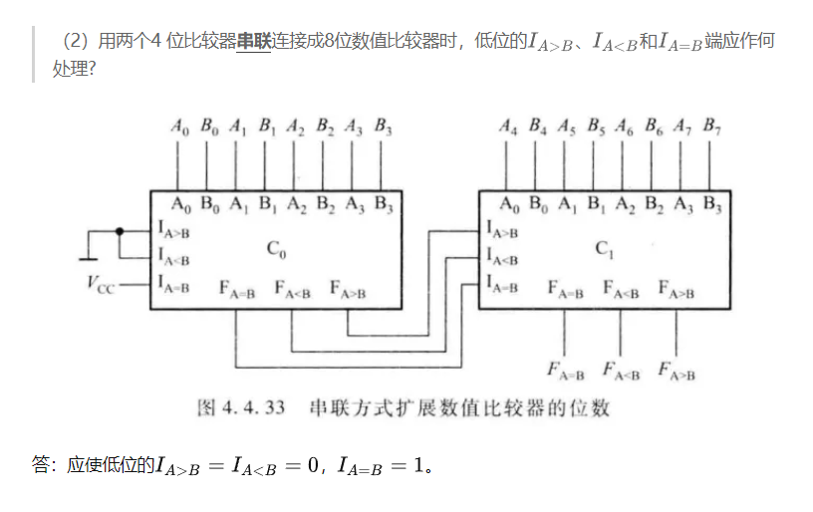
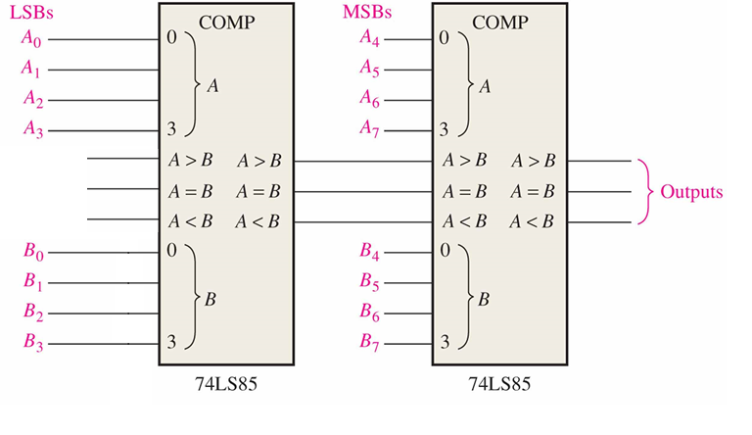
5. An 8-bit comparator using 74LS85 is shown. The three input of the lowest order comparator should be F_{A>B}=_____, F_{A=B}=______, F_{A<B}=___.
0
1
0

Slide 11
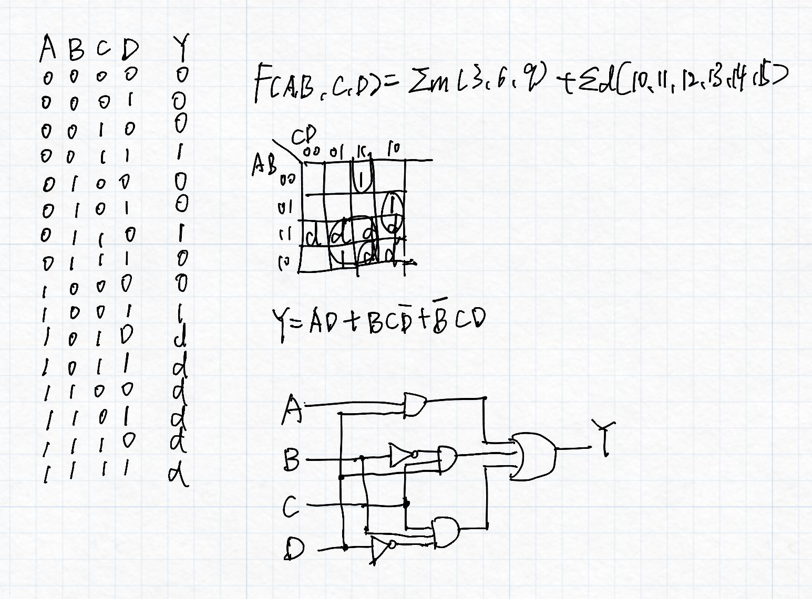
6. Develop a logic circuit for detecting whether a 8421BCD code is a multiple of three. If it is, the output should be true.
(a)construct the truth table;
(b) write the logic expression and simplify it;
(c) draw the logic circuit.

Slide 12
7. Consider the three-variable function f(a,b,c) = bc’+ab’+abc
1) Give its canonical SOP and canonical POS.
2) Implement the function using nand gates only.
3) Implement the function using 3-8 decoder.
4) Implement the function using 4-16 decoder.
5) Implement the function using 1-of-4 multiplexer (use a, b as select inputs).

Slide 13
4. Consider the 3-variable function f(a,b,c) = bc’+ab’+abc
1) (10p) Give its canonical SOP and canonical POS.
2) (10p) Implement the function using nand gates.
b
c’
1
a
f

Slide 14
4. Consider the 3-variable function f(a,b,c) = bc’+ab’+abc
3) (15p) Implement the function using 3-line-to-8-line decoder.
0
0
1
E₁
E₂ E₃
O₀ O₁
O₂ O₃ O₄ O₅ O₆ O₇
74138
A₂ A₁ A₀
a
b
c
&
F

Slide 15
4. Consider the 3-variable function f(a,b,c) = bc’+ab’+abc
4) (15p) Implement the function using 4-16 decoder.
0
E
Y₀ Y₁ Y₂ Y₃ Y₄ Y₅ Y₆ Y₇
Y₈
Y₉
…
Y₁₅
Decoder
0
a
b
c
A₃ A₂ A₁ A₀
&
f
.
.
.

Slide 16
4. Consider the 3-variable function f(a,b,c) = bc’+ab’+abc
5) (15p) Implement the function using 1-of-4 multiplexer(use a, b as select inputs).
MUX
0
c’
1
1
D₀
D₁
D₂
D₃
f(a,b,c)
Y
则，
G A₁ A₀
a b

Slide 17
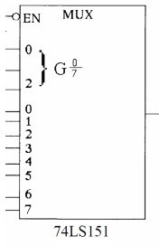
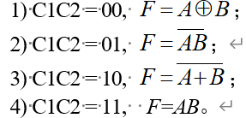
8. There are 2 control signals: C1 and C2，design a circuit using a 74LS151 data selector.

Slide 18
5. There are 2 contral signals: C₁ and C₂，design a circuit using an 1-of-8 MUX.
1) ， ； 2) ， ；
3) ， ； 4) ， 。
C₂C₁ | AB | F
0 0 0 0 0 0 0 0 | 0 0 0 1 1 0 1 1 | 0 1 1 0
0 1 0 1 0 1 0 1 | 0 0 0 1 1 0 1 1 | 1 1 1 0
1 0 1 0 1 0 1 0 | 0 0 0 1 1 0 1 1 | 1 0 0 0
1 1 1 1 1 1 1 1 | 0 0 0 1 1 0 1 1 | 0 0 0 1
MUX
74LS151
D₀
D₁
D₂
D₃
D₄
D₅
D₆
D₇
D₀
D₁
D₂
D₃
D₄
D₅
D₆
D₇
B
B’
1
B’
B’
0
0
B
F
Y
G A₂ A₁ A₀
C₂ C₁ A

Slide 19
2^{n}
4
1. A modulus-13 counter has 13 states requiring __ flip-flops. A modulus-13 ring counter requiring ____ flip-flops.
13
n
2. Assume the clock for a 3-bit binary counter is 16MHz. The output frequency of the third stage (Q2) is ( )
a. 2MHz b. 128MHz c. 5.33MHz d. 48MHz
a
3. An asynchronous counter differs from a synchronous counter in ( ).
a. the number of states in its sequence. b. the method of clocking.
c. the type of flip-flops used. d. the value of the modulus.
b

Slide 20
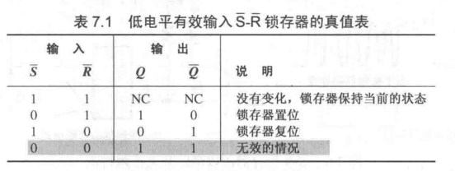
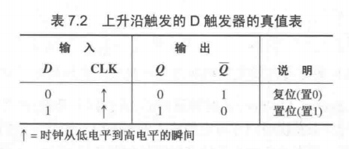
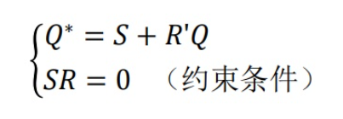
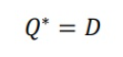
4. A 4-bit binary up/down counters is in the binary state of 0111. The next state in the DOWN mode is
0110
5. List the true tables and the characteristic equations of SR flip-flop, JK flip-flop and D flip-flop

Slide 21
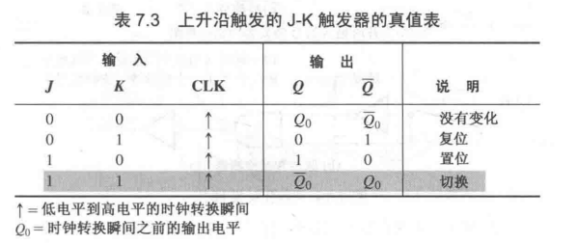
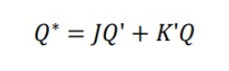

Slide 22
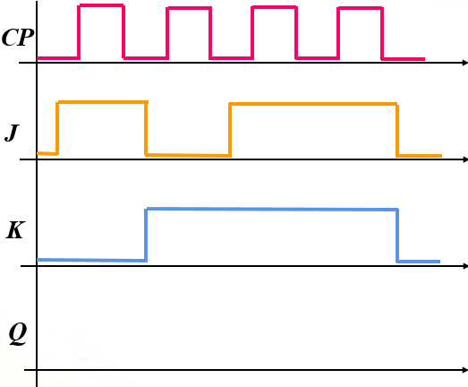
6. In the figure for this problem, complete the timing diagram for a positive edge triggered J-Kflip-flop.

Slide 23
set reset toggle toggle

Slide 24
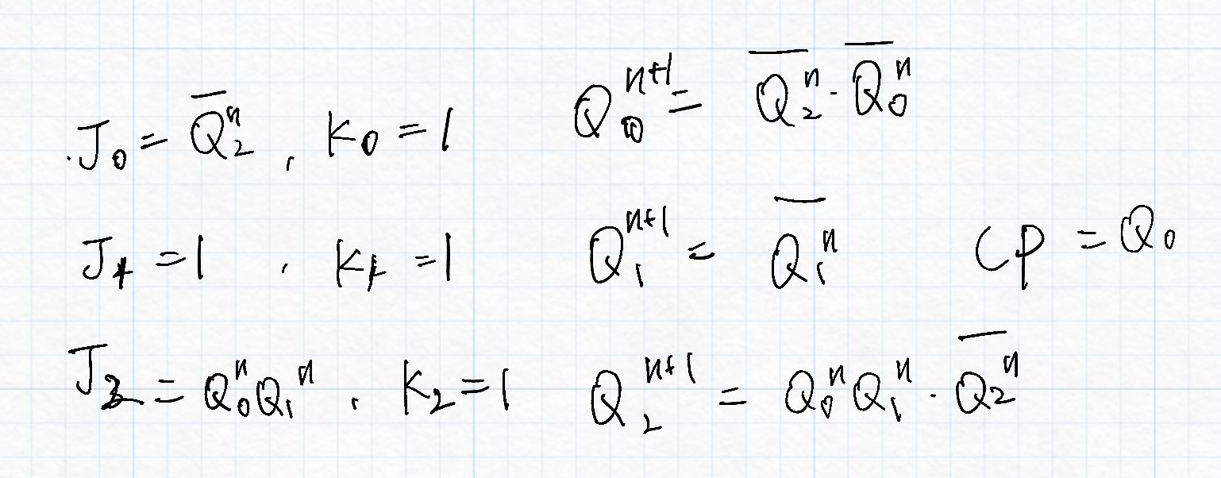
7. Given the logic diagram and CP for this problem, complete the Q0, Q1 and Q2 waveforms.

Slide 25
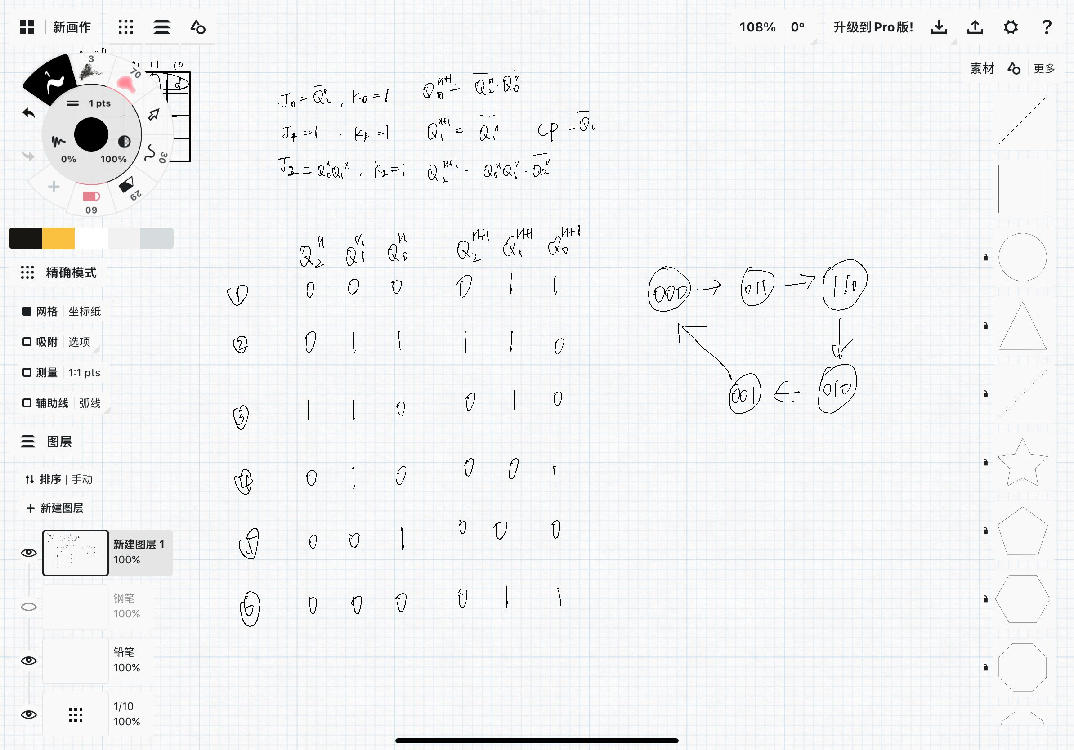

Slide 26
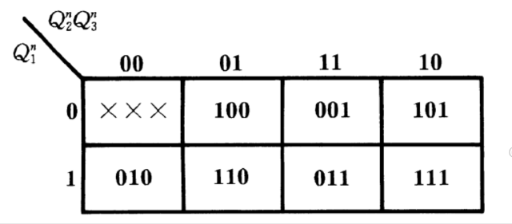
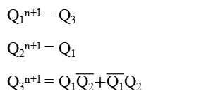
8. Design a counter to produce the following binary sequence with J-K flip-flops: 1, 4, 3, 5, 7, 6, 2, 1,...
001
100
011
101
111
110
010
Q₁Q₂Q₃
Q₁^{n+1} = Q₃
Q₂^{n+1} = Q₁
Q₃^{n+1} = Q₁$\overline{Q2}$+$\overline{Q1}$Q$2$
100
101
001
011
111
110
010
X
1
1
0
X
0
0
0
X
0
1
1
0
1
1
0
1
1
1
1
1
1
0
0
Q₁^{n+1}
Q₂^{n+1}
Q₃^{n+1}

Slide 27

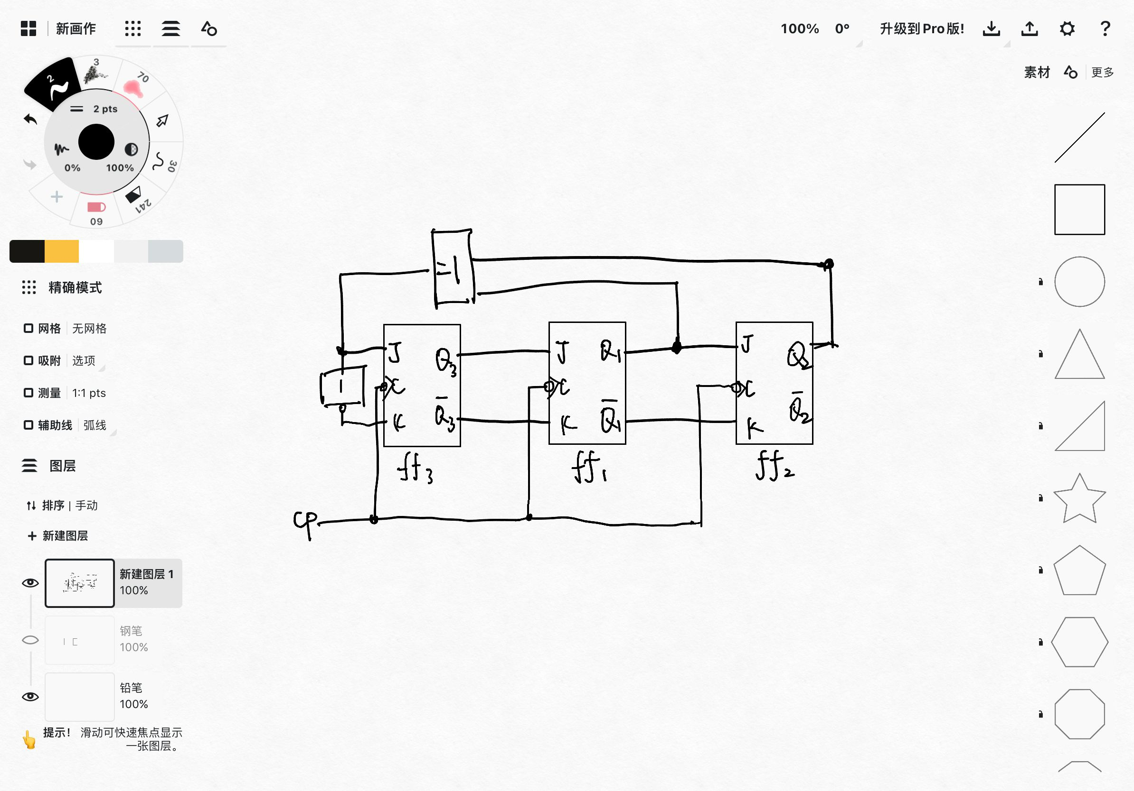
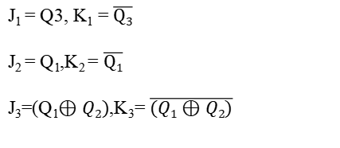
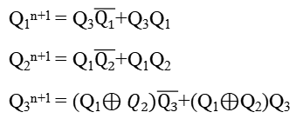
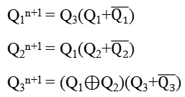
Q₁^{n+1} = Q₃(Q₁+$\overline{Q1}$)
Q₂^{n+1} = Q₁(Q₂+$\overline{Q2}$)
Q₃^{n+1} = (Q₁$⊕$Q₂)(Q₃+$\overline{Q3}$)
Q₁^{n+1} = Q₃$\overline{Q1}$+Q₃Q₁
Q₂^{n+1} = Q₁$\overline{Q2}$+Q₁Q₂
Q₃^{n+1} = (Q₁$⊕Q2)\overline{Q3}$+(Q₁$⊕$Q₂)Q₃
J₁ = Q3, K₁ = $\overline{Q3}$
J₂ = Q₁,K₂ = $\overline{Q1}$
J₃=(Q₁$⊕Q2)$,K₃= $\overline{(Q1⊕Q2)}$
J
C
K
Q
$$\overline{Q}$$
J
C
K
Q
$$\overline{Q}$$
J
C
K
Q
$$\overline{Q}$$
ff₁
ff₂
ff₃

Slide 28
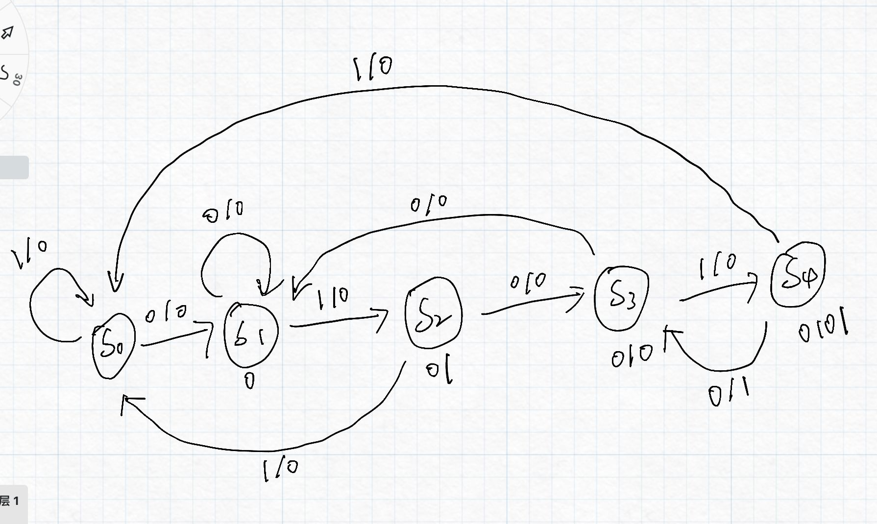
9. Construct a Mealy state diagram that will detect a serial input sequence of 01010

Slide 29
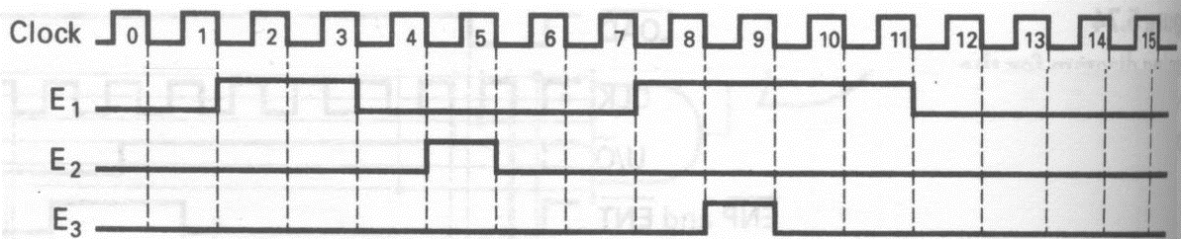
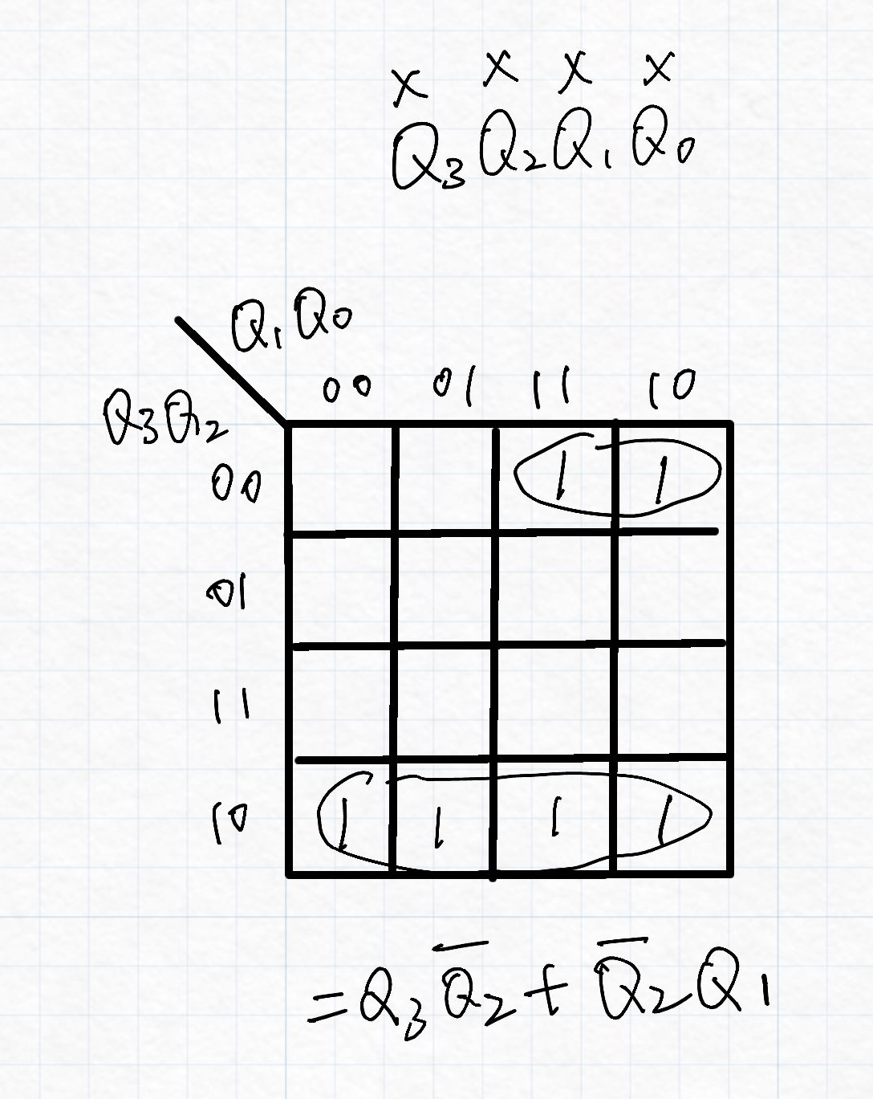
10. Using counter to realize following control signals E1,E2, E3.
E₁: 0010, 0011, 1000 , 1001, 1010, 1011
E₂ : 0101
E₃ : 1001

Slide 30
